Slide 1
DATA SCIENCE
PRELMINARY REPORT FOR FINAL PROJECT
SUBMITTED BY :
ANVIKA

Slide 2
SCENARIO
The presidential elections for the United states are to be held in 2016 and to reach the people, candidates have to accord to the demands of the smart American population.
Data science has always been used for prediction about the outcome of events like elections, but one of the candidates thought of using it in a different way.
They hired a data scientist and provided him with two data sets of housing and population.
The data set had an obvious characterize of being too large with more than 2 million records and around 283 dimensions.
Interesting attributes include: Ancestral information, family size, wifi connection, wages, information on language etc.

Slide 3
SCENARIO
The task was to find unique patterns in the data set that would help formulate agendas for the client candidate.
This would make the agendas:
Quite unique(not the same rants, but more logical ones)
Identify areas which require improvement.
Formulate new norms like for immigration etc (reach worldwide)
Allocation of projects and acceptance to profitable business plans region wise
And many more as data is power.

Slide 4
Challenge for the Data Scientist
Huge data set to be analyzed, must be scalable.
Predictions have high utility.

Slide 5
STEPS TAKEN BY THE DATA SCIENTIST
Take input from the client
Visually analyze the data and understand the implication of every attribute.
Eliminate the attributes which are quite not necessary.
Work with the comparatively small data.
Highlight the domains to be focused on like women empowerment, education, immigration laws etc.

Slide 6
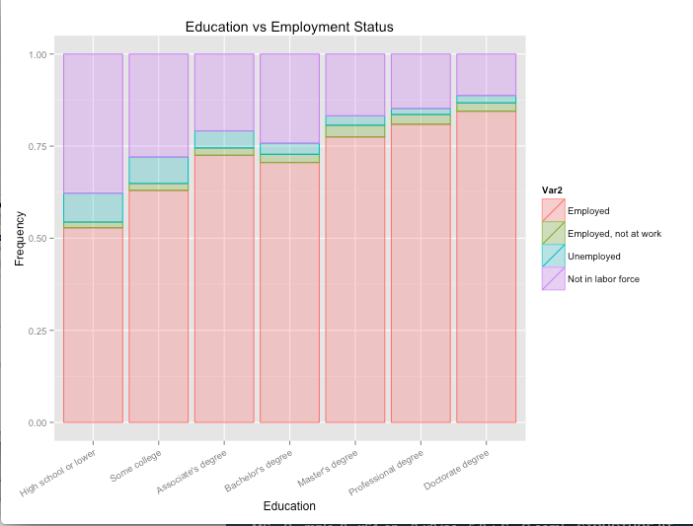
Since the employment rate is high for master’s and P.H.D. it attract students worldwide to pursue higher studies in the United States instead of a bachelor’s degree.

Slide 7
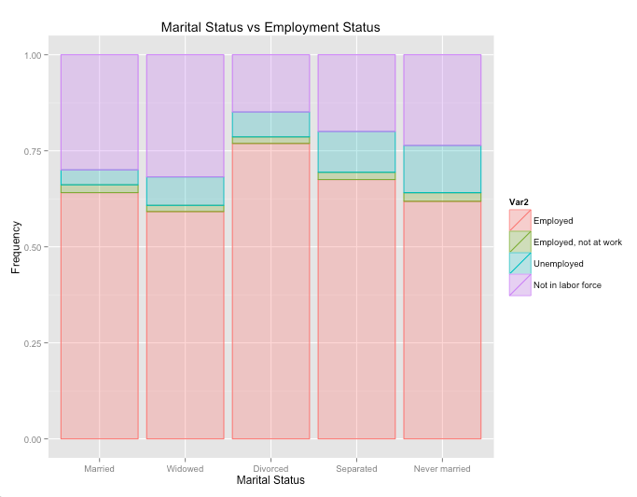
Married people work more than the single people to improve their economic status, divorced turn into workaholics.

Slide 8
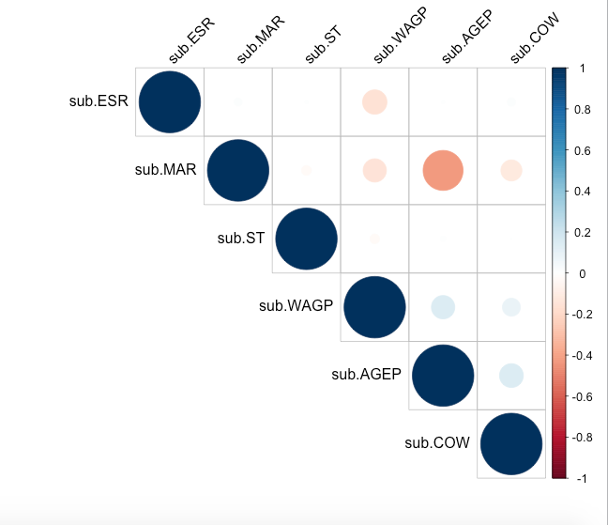
Correlation between the following:

Slide 9
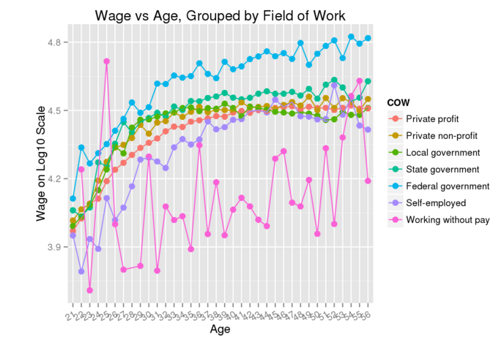

Slide 10
Age and class of worker(COW) has a positive correlation. As the age increases more people tend to be self-employed or unemployed.
The correlation graph shows a negative correlation between marital status and class of worker, but earlier graph shows that maximum married people are employed.
The reason could be that some women tend to either be unemployed or work without pay after marriage.
The count of languages spoken at home, ranked Chinese and Spanish as the top 2, which can be attributed to Chinese being the highest immigrants of the country or whose ancestors hailed to the States.
The states like Wisconsin, Utah, Texas have lower property taxes and therefore had more old people with own house residing them.

Slide 11
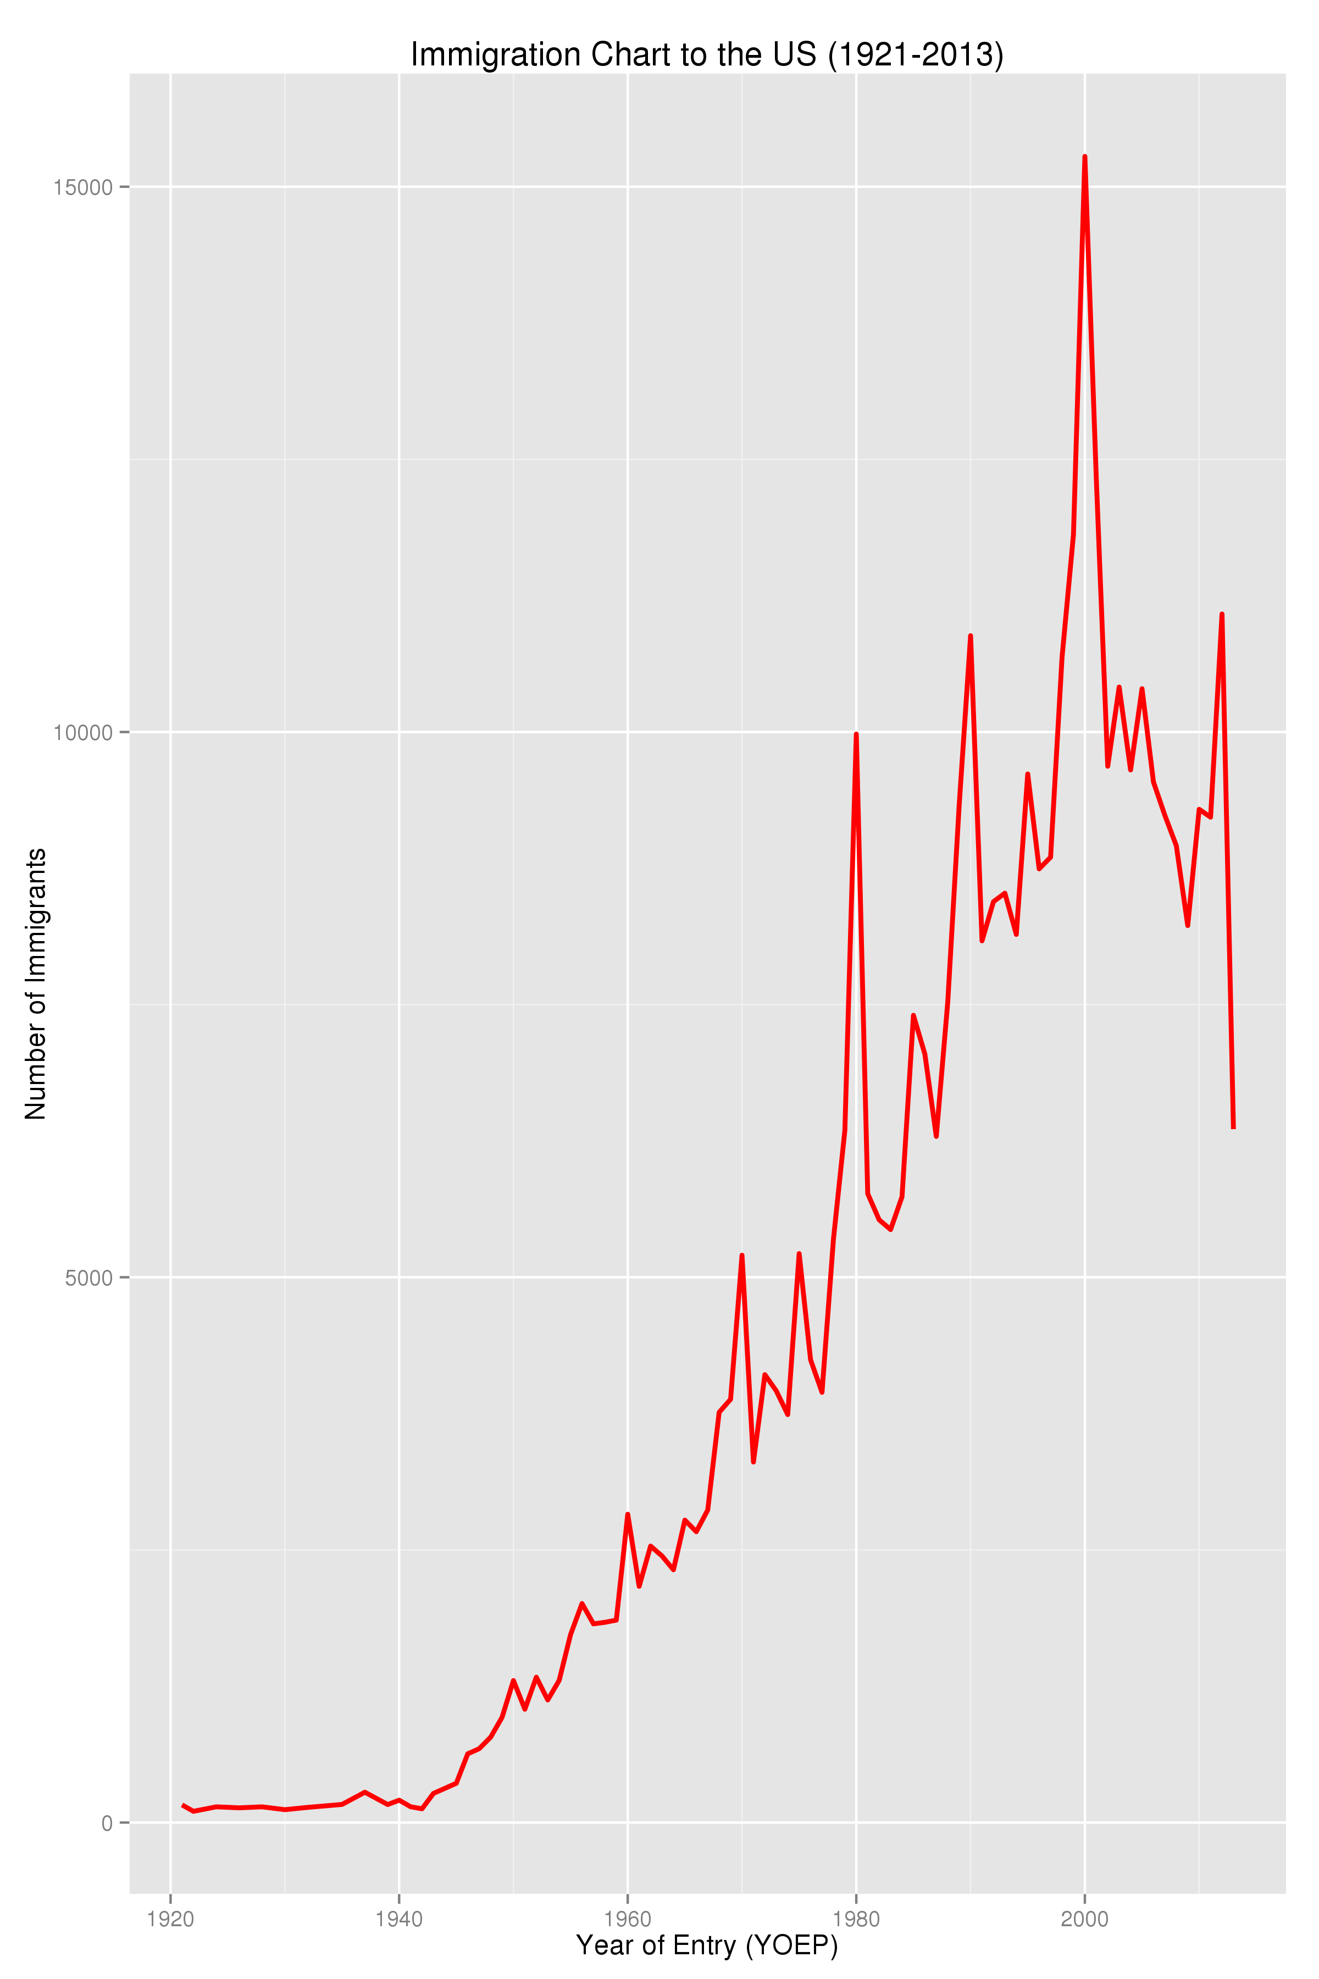
Immigration rate has decreased sharply after 2001, which can be attributed to the attacks of 9/11, measured by the Year of Entry attribute.

Slide 13
The wages for differently abled people was lower than the rest of the population and many were unemployed as well as unmarried or separated.
Work per hour of married people was less than that of single people(probably lot of vacations).
Hearing disability was considered more as a marriage criteria than cognitive disability i.e. more number of people with hearing disability were single than those with cognitive disability.
Men worked more than women.
Women had lower wage than men.

Slide 14
DATA DICTIONARY
The data description is attached for reference.
http://www2.census.gov/programs-surveys/acs/tech_docs/pums/data_dict/PUMSDataDict13.txt

